Slide 1


Developing Infrastructure as Code
Talk
Notes:
You can change the colour of the left hand panel and even use an image behind this.
Side Panel Title
Font: Arial Bold
Colour: White
Size: 20pt (minimum size)
Side Panel Intro Text
Font: Arial
Colour: White
Size: 12pt (minimum size)
A range of icons is available at the end of this slide deck.
Title
Font: Arial Bold
Colour: White
Size: 32pt (minimum size)
Sub title
Font: Arial Bold
Colour: Blue
Size: 14pt (minimum size)
Body copy
Font: Arial Bold
Colour: Grey
Size: 12pt (minimum size)

Slide 2
Senior Infrastructure Engineer (DevOps)
Exchange 2010 -> Office 365 -> Azure AD
Platform as a Service
Bout me
Gareth Rooney
MCSE Cloud Platform and Infrastructure
Notes:
You can change the colour of the left hand panel and even use an image behind this.
Side Panel Title
Font: Arial Bold
Colour: White
Size: 20pt (minimum size)
Side Panel Intro Text
Font: Arial
Colour: White
Size: 12pt (minimum size)
A range of icons is available at the end of this slide deck.
Title
Font: Arial Bold
Colour: White
Size: 32pt (minimum size)
Sub title
Font: Arial Bold
Colour: Blue
Size: 14pt (minimum size)
Body copy
Font: Arial Bold
Colour: Grey
Size: 12pt (minimum size)

Slide 3
Talk
ARM Templates
What is a WebApp?
Manual methods to deploy to Azure
Traffic Manager
Team Services CI\CD Automation
Microsoft use of Team Services
Notes:
You can change the colour of the left hand panel and even use an image behind this.
Side Panel Title
Font: Arial Bold
Colour: White
Size: 20pt (minimum size)
Side Panel Intro Text
Font: Arial
Colour: White
Size: 12pt (minimum size)
A range of icons is available at the end of this slide deck.
Title
Font: Arial Bold
Colour: White
Size: 32pt (minimum size)
Sub title
Font: Arial Bold
Colour: Blue
Size: 14pt (minimum size)
Body copy
Font: Arial Bold
Colour: Grey
Size: 12pt (minimum size)

Slide 4
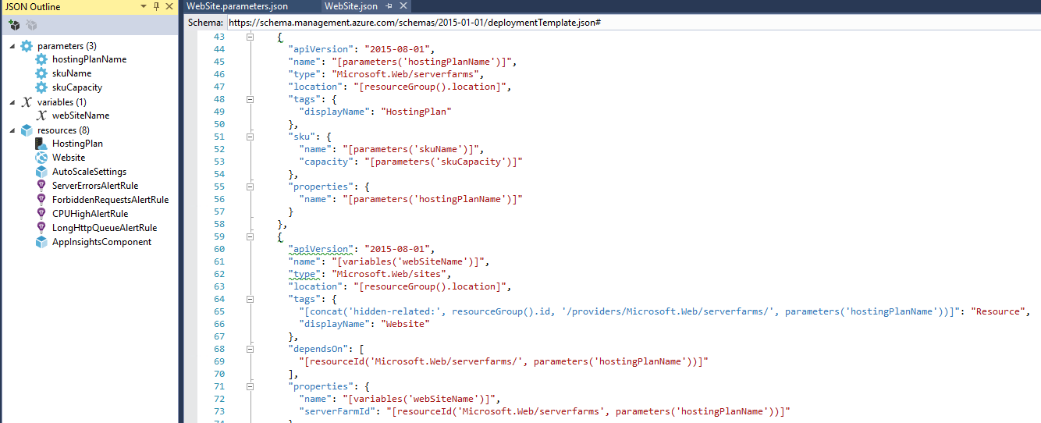
Azure
Resource
Manager Templates
Infrastructure as Code
JSON Format
Shopping List
Parameterise
Azure API
Notes:
You can change the colour of the left hand panel and even use an image behind this.
Side Panel Title
Font: Arial Bold
Colour: White
Size: 20pt (minimum size)
Side Panel Intro Text
Font: Arial
Colour: White
Size: 12pt (minimum size)
A range of icons is available at the end of this slide deck.
Title
Font: Arial Bold
Colour: White
Size: 32pt (minimum size)
Sub title
Font: Arial Bold
Colour: Blue
Size: 14pt (minimum size)
Body copy
Font: Arial Bold
Colour: Grey
Size: 12pt (minimum size)

Slide 5
Azure
WebApps
App service plan IIS/Apache
Public IP
DNS Name and PKI Cert
Custom DNS names
Deployment slots
Live metrics, monitoring and alerting
Kudu Project
Protection
Isolate App Service Environments
Notes:
You can change the colour of the left hand panel and even use an image behind this.
Side Panel Title
Font: Arial Bold
Colour: White
Size: 20pt (minimum size)
Side Panel Intro Text
Font: Arial
Colour: White
Size: 12pt (minimum size)
A range of icons is available at the end of this slide deck.
Title
Font: Arial Bold
Colour: White
Size: 32pt (minimum size)
Sub title
Font: Arial Bold
Colour: Blue
Size: 14pt (minimum size)
Body copy
Font: Arial Bold
Colour: Grey
Size: 12pt (minimum size)

Slide 6
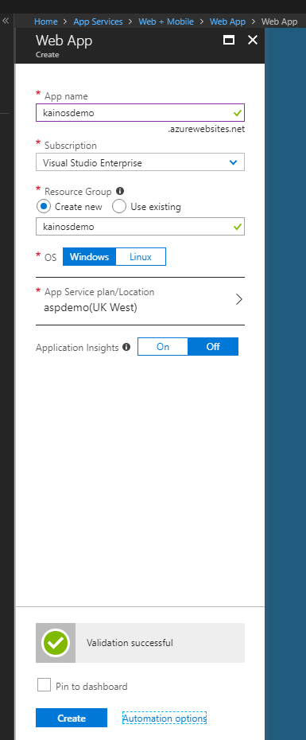
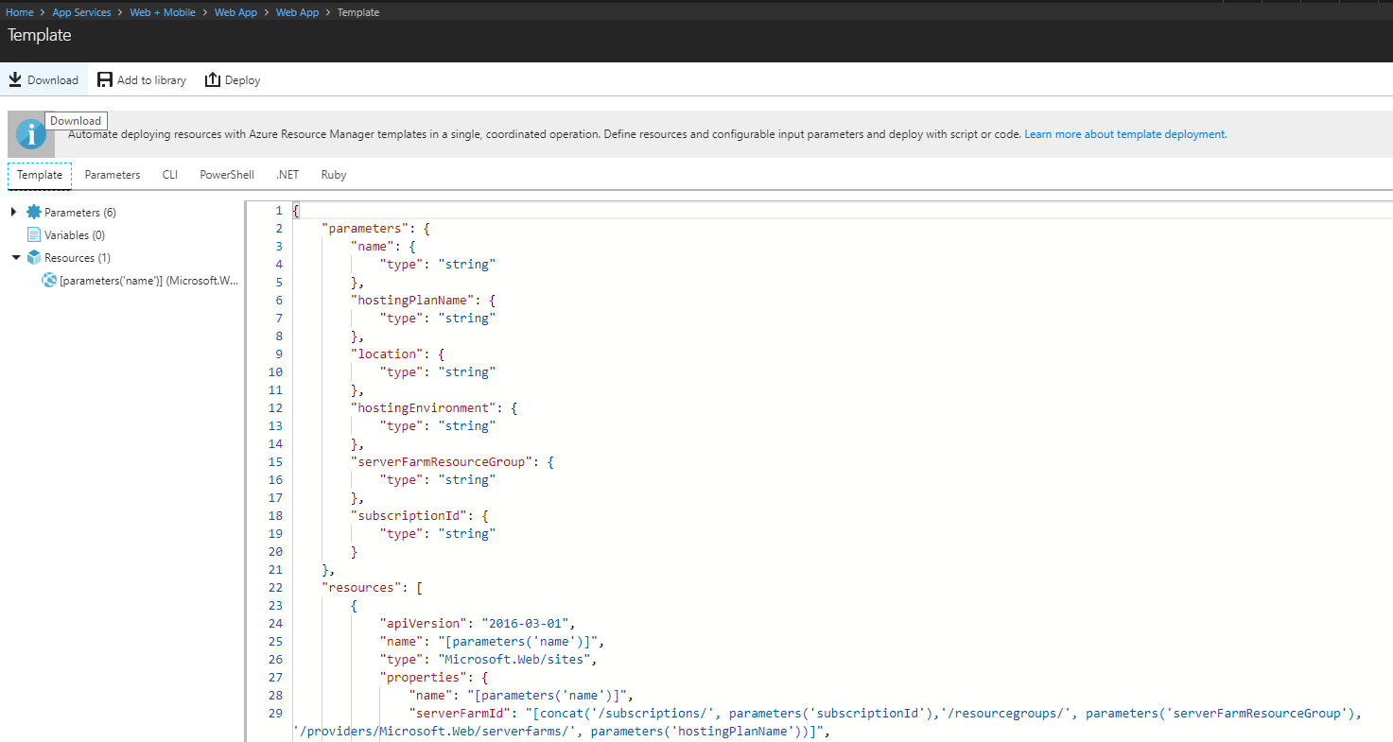
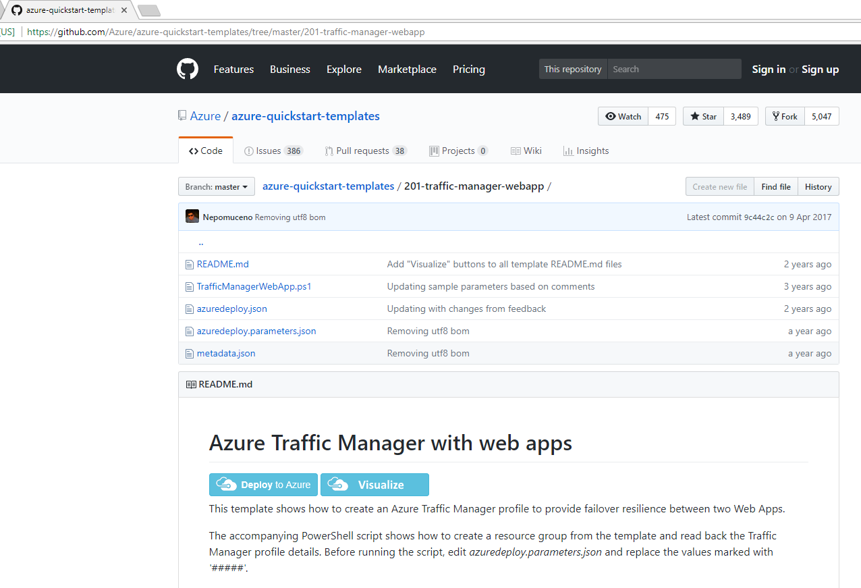
Manual Deployment
Demo
Notes:
You can change the colour of the left hand panel and even use an image behind this.
Side Panel Title
Font: Arial Bold
Colour: White
Size: 20pt (minimum size)
Side Panel Intro Text
Font: Arial
Colour: White
Size: 12pt (minimum size)
A range of icons is available at the end of this slide deck.
Title
Font: Arial Bold
Colour: White
Size: 32pt (minimum size)
Sub title
Font: Arial Bold
Colour: Blue
Size: 14pt (minimum size)
Body copy
Font: Arial Bold
Colour: Grey
Size: 12pt (minimum size)

Slide 7
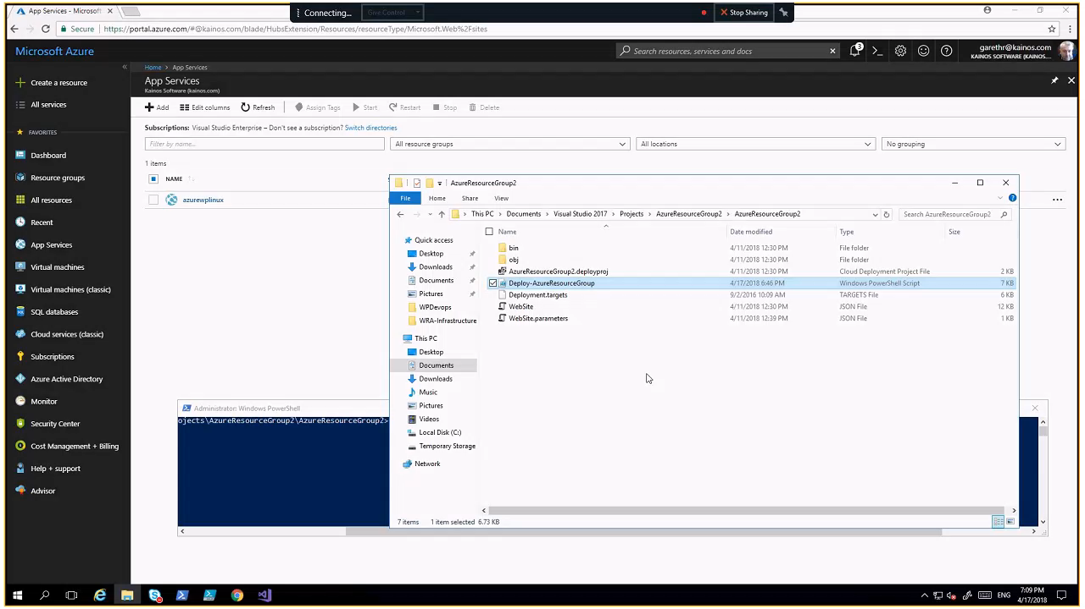
Manual Deployment
Demo
Notes:
You can change the colour of the left hand panel and even use an image behind this.
Side Panel Title
Font: Arial Bold
Colour: White
Size: 20pt (minimum size)
Side Panel Intro Text
Font: Arial
Colour: White
Size: 12pt (minimum size)
A range of icons is available at the end of this slide deck.
Title
Font: Arial Bold
Colour: White
Size: 32pt (minimum size)
Sub title
Font: Arial Bold
Colour: Blue
Size: 14pt (minimum size)
Body copy
Font: Arial Bold
Colour: Grey
Size: 12pt (minimum size)

Slide 8
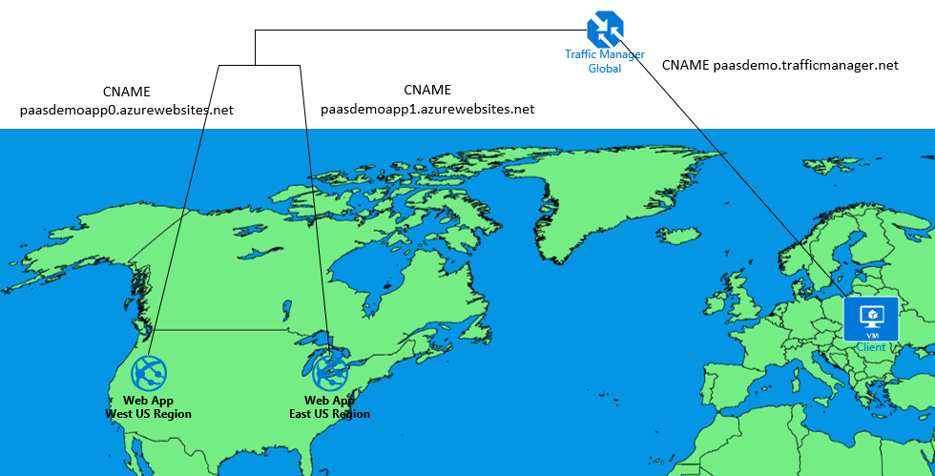
Demo
Azure Traffic Manager configured with
Azure WebApps in different Regions
Notes:
You can change the colour of the left hand panel and even use an image behind this.
Side Panel Title
Font: Arial Bold
Colour: White
Size: 20pt (minimum size)
Side Panel Intro Text
Font: Arial
Colour: White
Size: 12pt (minimum size)
A range of icons is available at the end of this slide deck.
Title
Font: Arial Bold
Colour: White
Size: 32pt (minimum size)
Sub title
Font: Arial Bold
Colour: Blue
Size: 14pt (minimum size)
Body copy
Font: Arial Bold
Colour: Grey
Size: 12pt (minimum size)

Slide 9
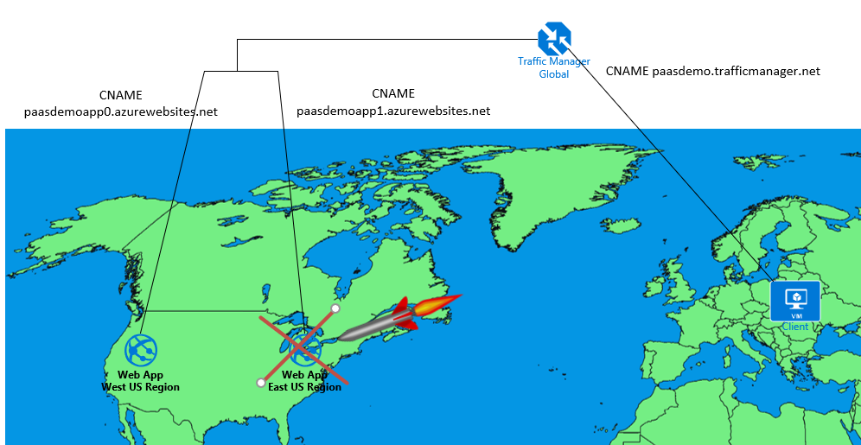
Demo
Azure Traffic Manager configured with
Azure WebApps in different Regions
Notes:
You can change the colour of the left hand panel and even use an image behind this.
Side Panel Title
Font: Arial Bold
Colour: White
Size: 20pt (minimum size)
Side Panel Intro Text
Font: Arial
Colour: White
Size: 12pt (minimum size)
A range of icons is available at the end of this slide deck.
Title
Font: Arial Bold
Colour: White
Size: 32pt (minimum size)
Sub title
Font: Arial Bold
Colour: Blue
Size: 14pt (minimum size)
Body copy
Font: Arial Bold
Colour: Grey
Size: 12pt (minimum size)

Slide 10
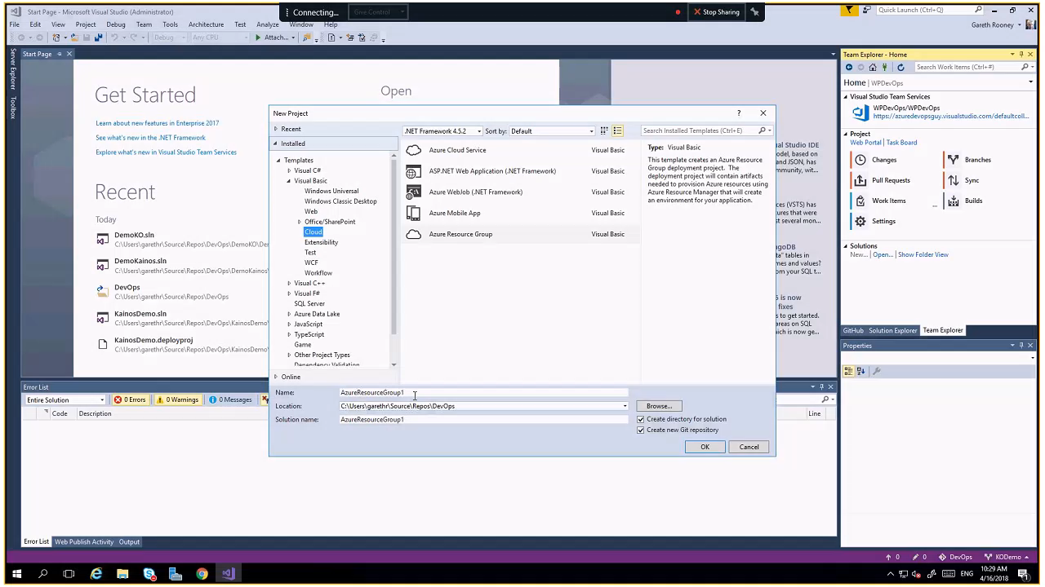
Team
Services
Demo
Notes:
You can change the colour of the left hand panel and even use an image behind this.
Side Panel Title
Font: Arial Bold
Colour: White
Size: 20pt (minimum size)
Side Panel Intro Text
Font: Arial
Colour: White
Size: 12pt (minimum size)
A range of icons is available at the end of this slide deck.
Title
Font: Arial Bold
Colour: White
Size: 32pt (minimum size)
Sub title
Font: Arial Bold
Colour: Blue
Size: 14pt (minimum size)
Body copy
Font: Arial Bold
Colour: Grey
Size: 12pt (minimum size)

Slide 11
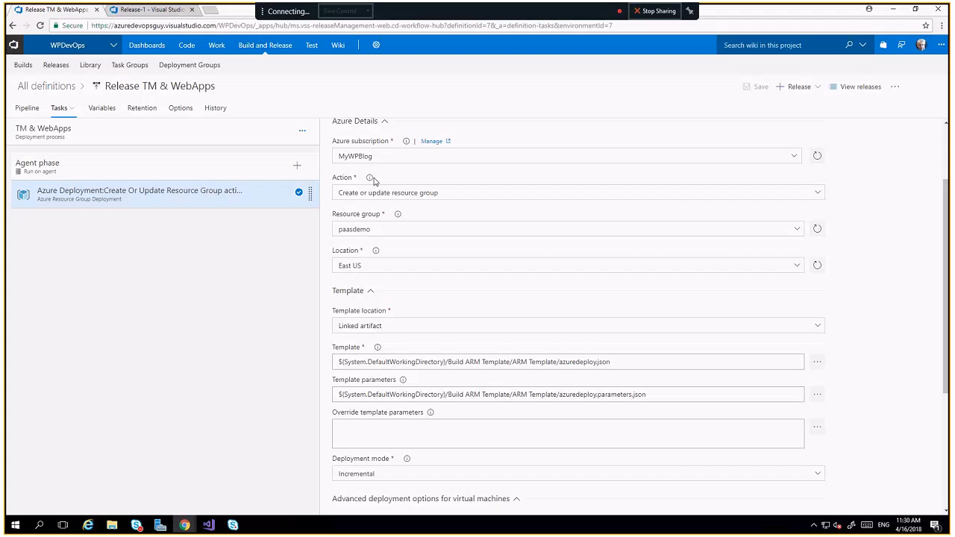
Mark and Gareth content
Insert text
Notes:
You can change the colour of the left hand panel and even use an image behind this.
Side Panel Title
Font: Arial Bold
Colour: White
Size: 20pt (minimum size)
Side Panel Intro Text
Font: Arial
Colour: White
Size: 12pt (minimum size)
A range of icons is available at the end of this slide deck.
Title
Font: Arial Bold
Colour: White
Size: 32pt (minimum size)
Sub title
Font: Arial Bold
Colour: Blue
Size: 14pt (minimum size)
Body copy
Font: Arial Bold
Colour: Grey
Size: 12pt (minimum size)

Slide 12
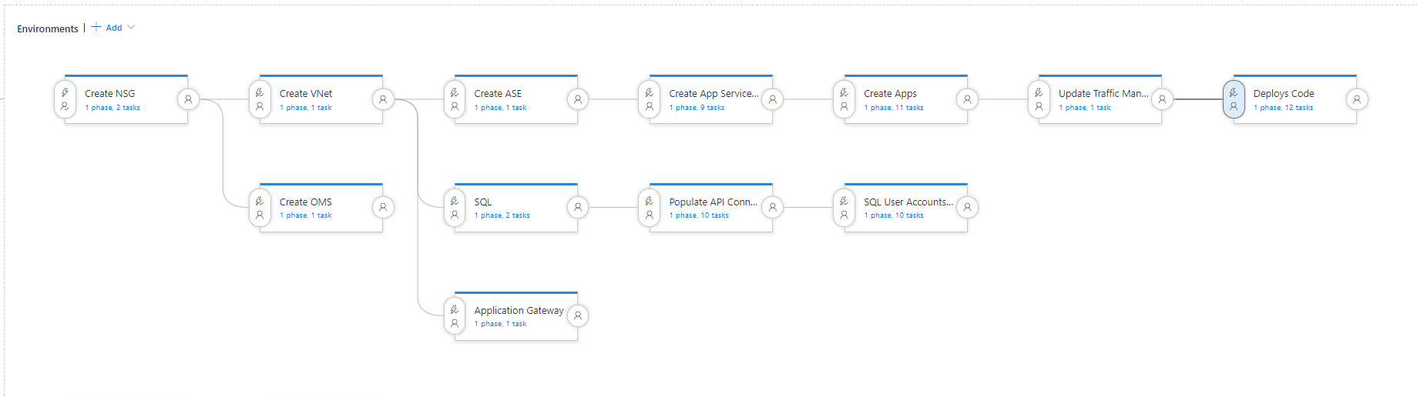
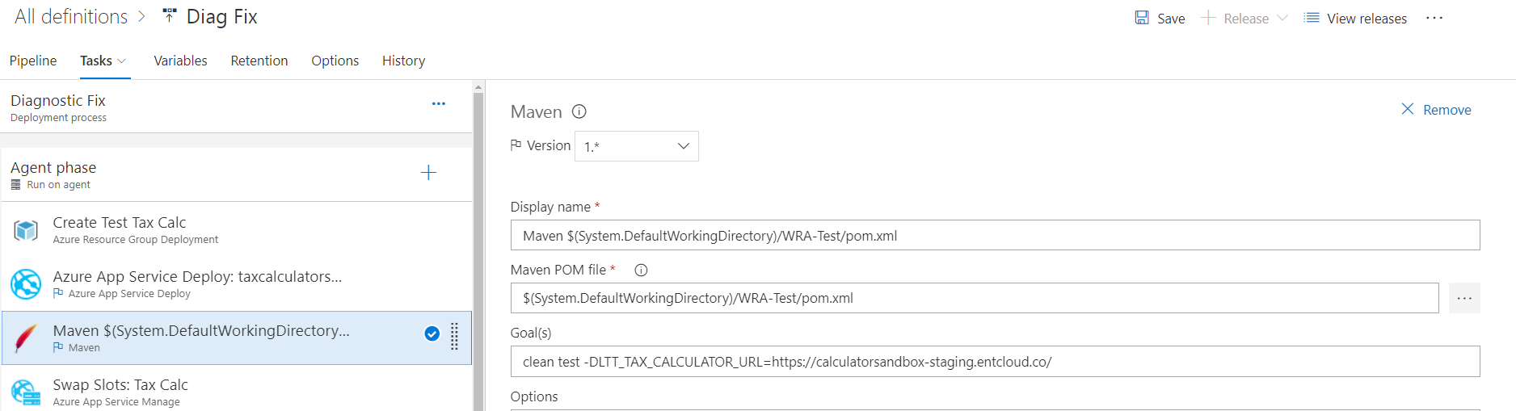
Complex Pipeline
Release Entire Infrastructure
How Microsoft use Team Services
Notes:
22,000 employees and 7,000 software developers
Windows core repo 270Gb – 4000 engineers 400 making changes at one time
Autumn Creators Update to Windows 10 - 4 million commits – 0.5 million pull requests
Part of the Azure Eco System - new functionality appears daily
2 Factor Authentication for Release Approvals
Team Services Marketplace – Build Radiator, Software Vulnerability Scanner
One Tool – GCP, Amazon, Docker, Kubernetes, Selenium Tests, Kanban Boards, Sprint Planning
Side Panel Title
Font: Arial Bold
Colour: White
Size: 20pt (minimum size)
Side Panel Intro Text
Font: Arial
Colour: White
Size: 12pt (minimum size)
A range of icons is available at the end of this slide deck.
Title
Font: Arial Bold
Colour: White
Size: 32pt (minimum size)
Sub title
Font: Arial Bold
Colour: Blue
Size: 14pt (minimum size)
Cognitive services
Body copy
Font: Arial Bold
Colour: Grey
Size: 12pt (minimum size)

Slide 13
Windows Deployment
Group
7000 Developers
270Gb Repo
4000 Engineers
400 committing changes at a time
4 million commits, 0.5 pull requests
Embedded in the Azure eco system
New functionality daily
2FA for approvals
Marketplace
One tool
How Microsoft use Team Services
Notes:
22,000 employees and 7,000 software developers
Windows core repo 270Gb – 4000 engineers 400 making changes at one time
Autumn Creators Update to Windows 10 - 4 million commits – 0.5 million pull requests
Part of the Azure Eco System - new functionality appears daily
2 Factor Authentication for Release Approvals
Team Services Marketplace – Build Radiator, Software Vulnerability Scanner
One Tool – GCP, Amazon, Docker, Kubernetes, Selenium Tests, Kanban Boards, Sprint Planning
Side Panel Title
Font: Arial Bold
Colour: White
Size: 20pt (minimum size)
Side Panel Intro Text
Font: Arial
Colour: White
Size: 12pt (minimum size)
A range of icons is available at the end of this slide deck.
Title
Font: Arial Bold
Colour: White
Size: 32pt (minimum size)
Sub title
Font: Arial Bold
Colour: Blue
Size: 14pt (minimum size)
Cognitive services
Body copy
Font: Arial Bold
Colour: Grey
Size: 12pt (minimum size)

Slide 14
Thanks for listening
Any questions?
Notes:
22,000 employees and 7,000 software developers
Windows core repo 270Gb – 4000 engineers 400 making changes at one time
Autumn Creators Update to Windows 10 - 4 million commits – 0.5 million pull requests
Part of the Azure Eco System - new functionality appears daily
2 Factor Authentication for Release Approvals
Team Services Marketplace – Build Radiator, Software Vulnerability Scanner
One Tool – GCP, Amazon, Docker, Kubernetes, Selenium Tests, Kanban Boards, Sprint Planning
Side Panel Title
Font: Arial Bold
Colour: White
Size: 20pt (minimum size)
Side Panel Intro Text
Font: Arial
Colour: White
Size: 12pt (minimum size)
A range of icons is available at the end of this slide deck.
Title
Font: Arial Bold
Colour: White
Size: 32pt (minimum size)
Sub title
Font: Arial Bold
Colour: Blue
Size: 14pt (minimum size)
Cognitive services
Body copy
Font: Arial Bold
Colour: Grey
Size: 12pt (minimum size)

